Slide 1
RCANN – A ReConfigurable Artificial Neural Network for Iris Flower Classification
Matthew Griessler and Nick Landy

Slide 2
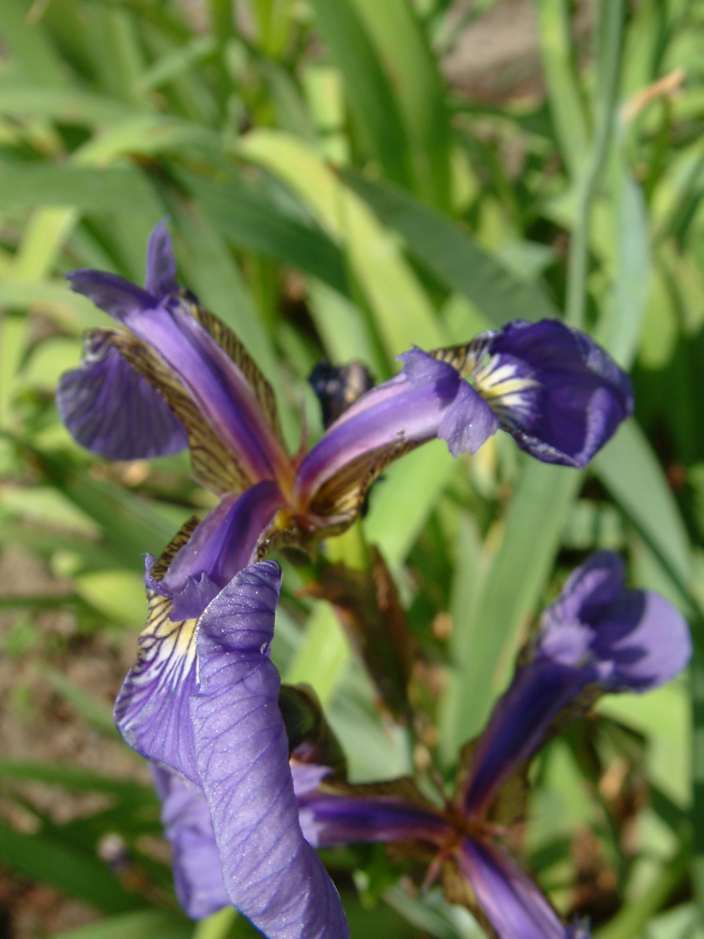
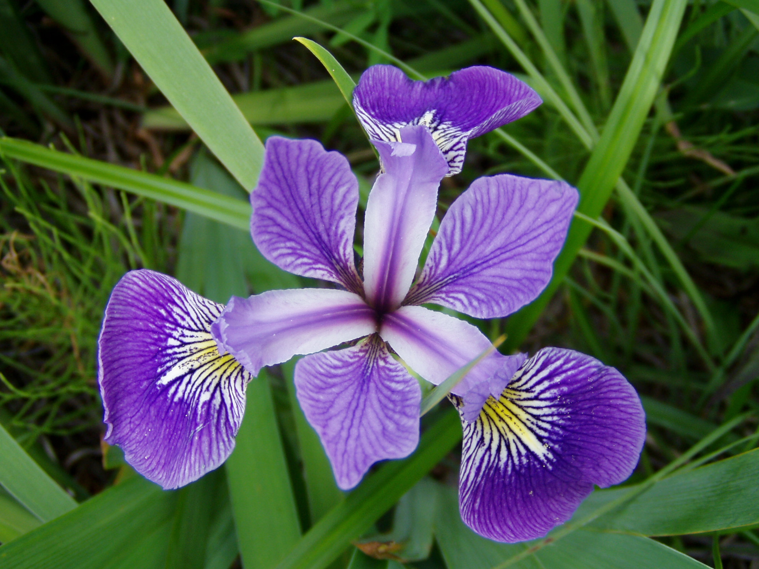
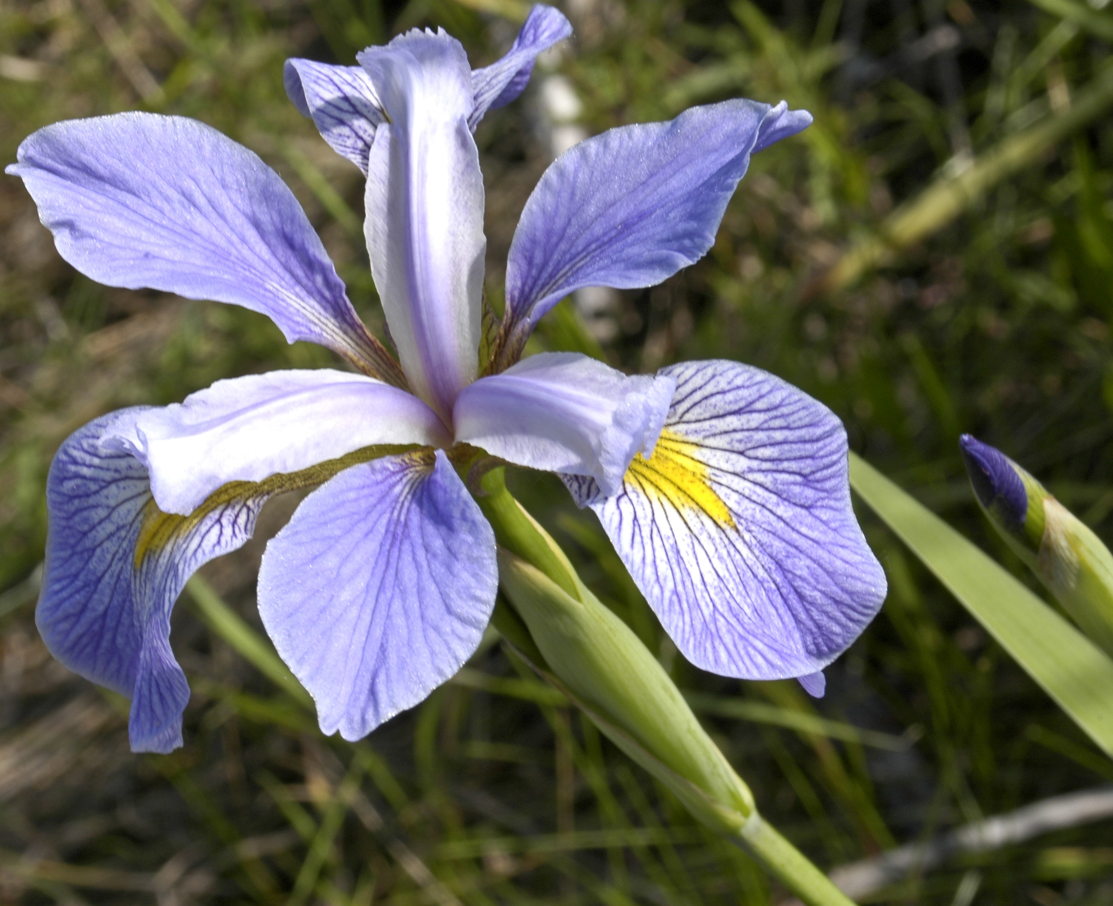
RCANN
Project Description:
RCANN is a configurable neural network implemented with reconfigurable computing principles on a ZYNC SoC
Project Demonstration:
RCANN is configured for the Iris flower dataset and the functionality is demonstrated. The Iris flower dataset is a dataset commonly used in classification algorithm development
From left to right: Iris setosa, Iris versicolor, Iris virginica

Slide 3
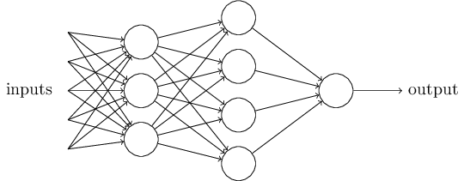
What is a Neural Network
Input Layer
Hidden Layer
Output Layer
Examples of Common Datasets
Dataset | Input Layer | Hidden Layer | Output Layer
MNIST Handwriting | 784 | 15 | 10
Iris flower | 4 | 15 | 3

Slide 4

What is a Neural Network
Why three layers??
Input Layer
Hidden Layer
Output Layer
Examples of Common Datasets
Dataset | Input Layer | Hidden Layer | Output Layer
MNIST Handwriting | 784 | 15 | 10
Iris flower | 4 | 15 | 3

Slide 5
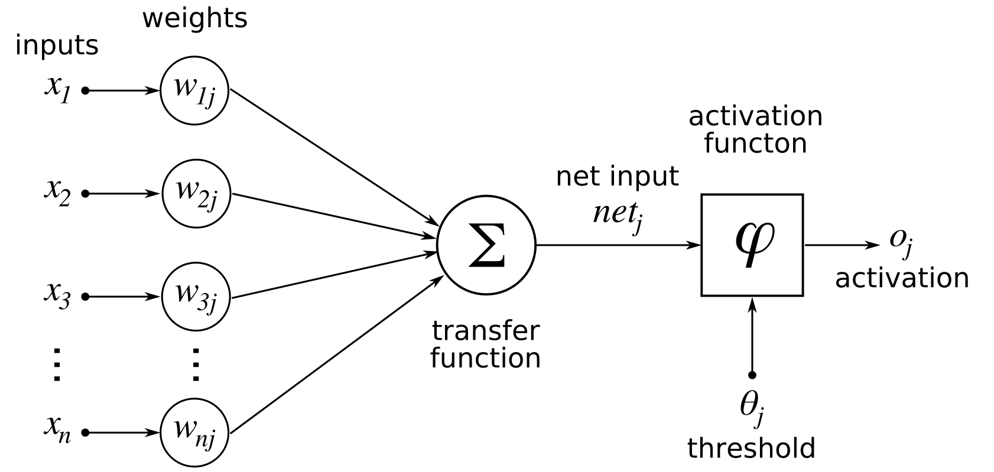
Neural Network - Node
It all starts with the node

Slide 6
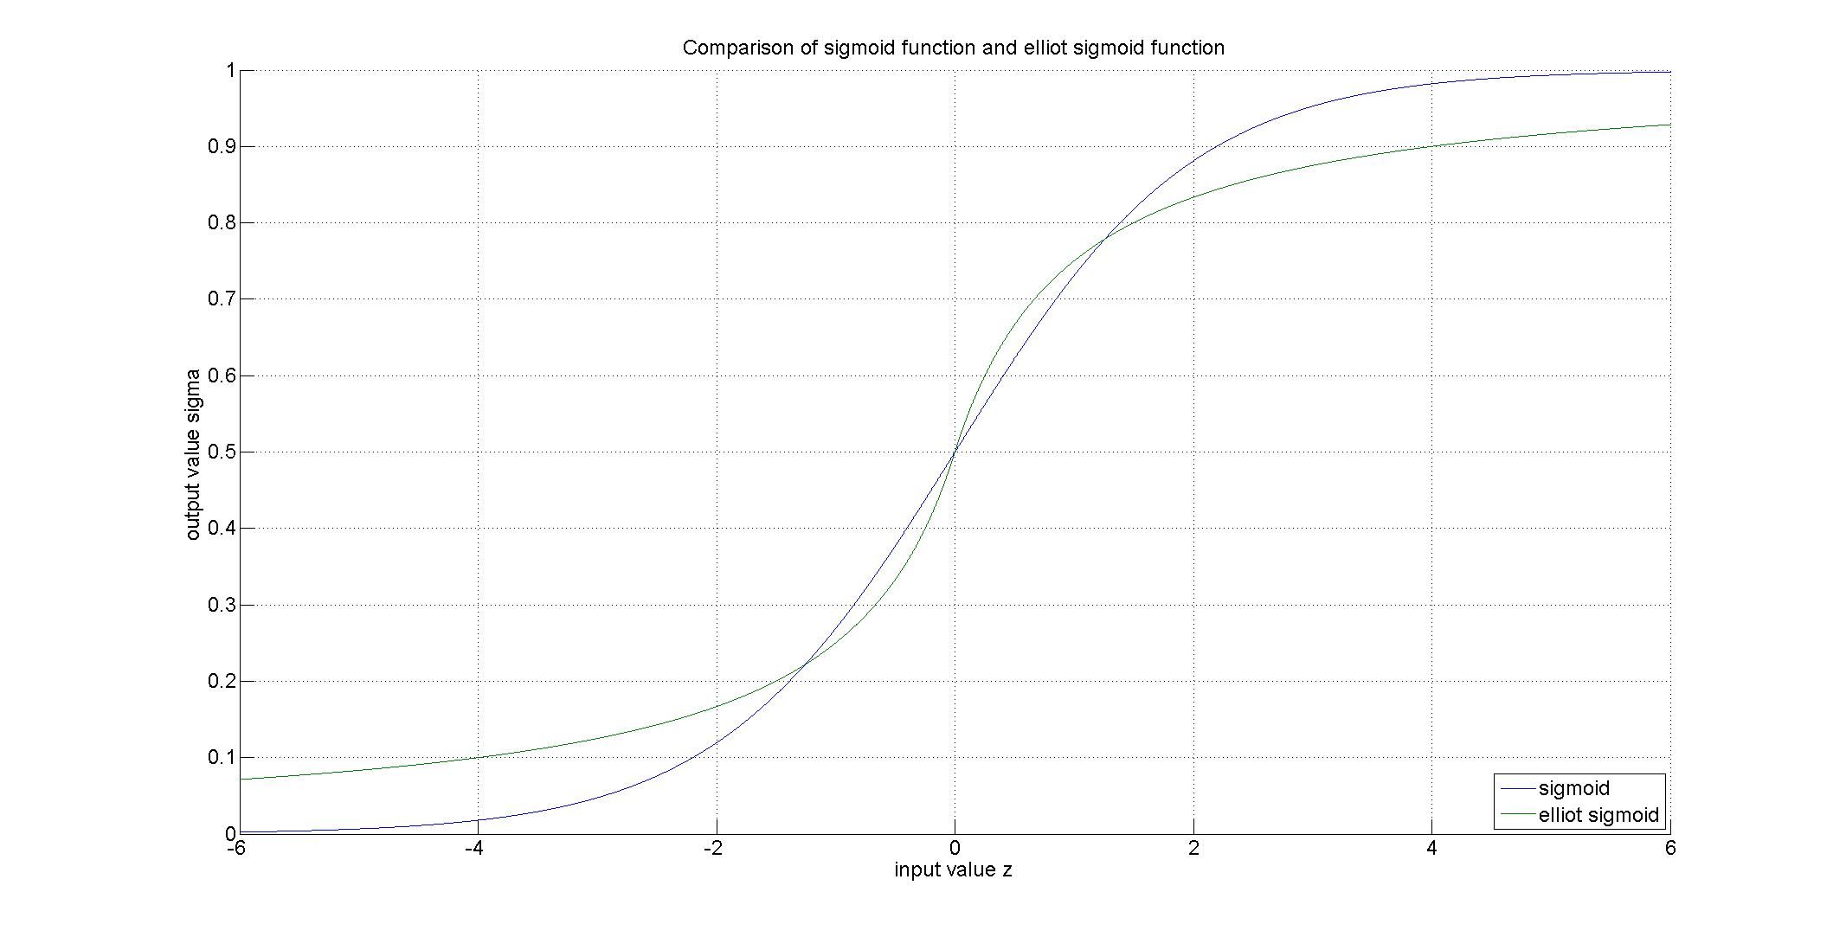
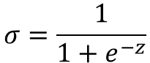
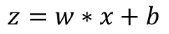
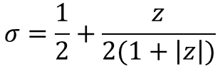
Neural Network – Activation Function
Sigmoid function
$$σ=\frac{1}{1+e^{−z}}$$
Elliot Sigmoid function
$$σ=\frac{1}{2}+\frac{z}{2(1+\left|z\right|)}$$
$$z=w∗x+b$$

Slide 7
Neural Network – Forward Pass
Process layers in order: first layer, hidden layer, output layer
Within a layer, nodes can be processed in parallel
Each node requires a multiply, accumulate, and activation function evaluation to get an output

Slide 8
Neural Network – Forward Pass
All weights and thresholds (or biases) start out randomized.
The network self-adjusts the weights and thresholds during training to increase accuracy of network.
RCANN is designed for cross-validation training.

Slide 9
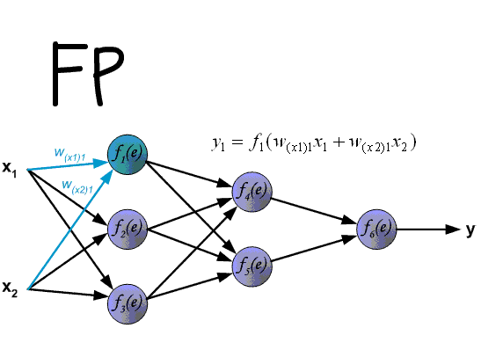
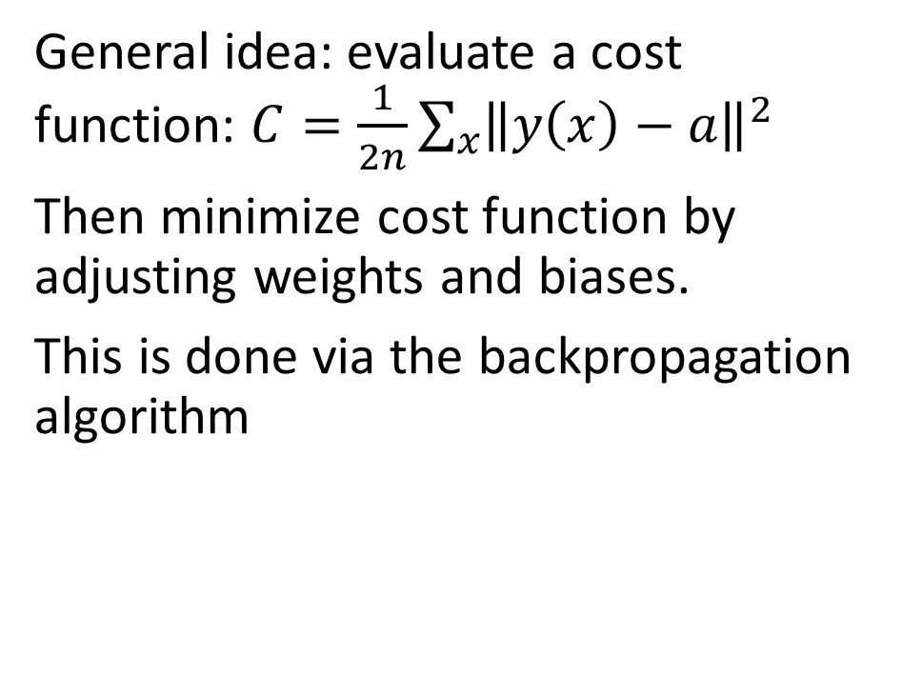
Neural Network - Backpropagation
General idea: evaluate a cost function: $C=\frac{1}{2n}\sum_{x}{{\left\|y\left(x\right)−a\right\|}^{2}}$
Then minimize cost function by adjusting weights and biases.
This is done via the backpropagation algorithm

Slide 10
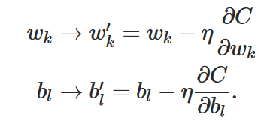
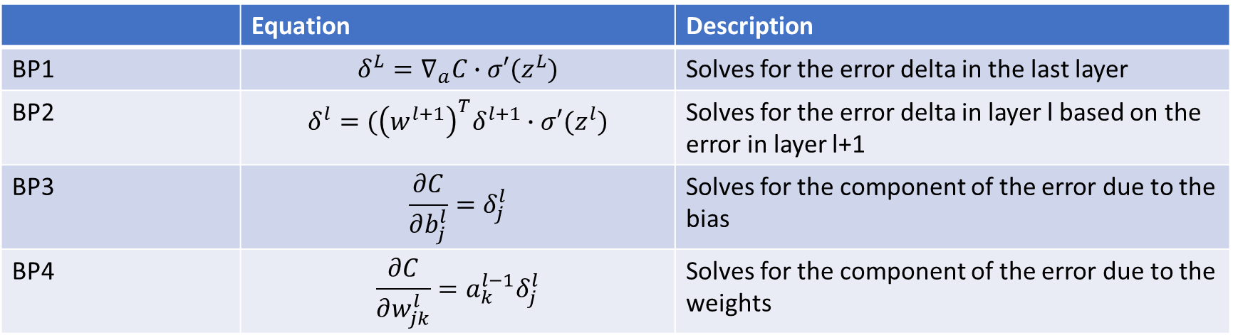
Neural Network - Backpropagation
 | Equation | Description
BP1 | $$δ^{L}=∇_{a}C∙σ′(z^{L})$$ | Solves for the error delta in the last layer
BP2 | $$δ^{l}=({\left(w^{l+1}\right)}^{T}δ^{l+1}∙σ′(z^{l})$$ | Solves for the error delta in layer l based on the error in layer l+1
BP3 | $$\frac{∂C}{∂b_{j}^{l}}=δ_{j}^{l}$$ | Solves for the component of the error due to the bias
BP4 | $$\frac{∂C}{∂w_{jk}^{l}}=a_{k}^{l−1}δ_{j}^{l}$$ | Solves for the component of the error due to the weights

Slide 11
Neural Network - Procedure
Neural network Use Procedure
Train for one epoch
Run verification
If performance is above threshold for accuracy (in our case 80%), go to step 4, otherwise, go back to step 1
Neural network is now ready for use with data where the answer isn’t known
Phase of Operation | Forward pass | Check Answer | Backpropagation
Training | Yes | Yes | Yes
Verification | Yes | Yes | No
Evaluation | Yes | No | No

Slide 12
Have we met our Requirements?
Req # | Requirement Description
General Requirements
G1 | Implement a neural network on an FPGA
G2 | Interface between FPGA and host computer
G3 | Demonstrate a speedup from implementation
G4 | Support training, verification, and evaluation
G5 | Support epoch and batch processing
Neural Network Requirements
N1 | Three layer network
N2 | Each layer can be configured with generic number of nodes
N3 | Implement forward pass, verification, and backpropagation
Forward Pass Requirements
F1 | Support pipe-lined and non-pipelined operation
F2 | Implement Elliot Sigmoid function for activation function
F3 | Take input from double buffered input memory
F4 | Put output into double buffered output memory
Verification Requirements
V1 | Check output against expected answer stored in double buffered memory
Backpropagation Requirements
B1 | Implement backpropagation equation BP1
B2 | Implement backpropagation equation BP2
B3 | Implement backpropagation equation BP3
B4 | Implement backpropagation equation BP4
B5 | Update node layer-layer weights
B6 | Update node biases

Slide 13
Implementation – Big Picture

Slide 14
Datapath Operation

Slide 15
Configure NN
Input Data
The number of epochs to train for.
Number of data per epoch
1: Turn on back propagation (training)
0: Turn off back propagation (testing)
Loads weights and biases into NN

Slide 16
Test Flowchart

Slide 17
Train Flowchart
Trains for a number of epochs specified by Num Epochs control signal

Slide 18
Neural Network Implementation

Slide 19
Block Diagram (Neural Network Datpath)
Input[3:0]
Clk
D
Q
D
Q
D
Q
D
Q
Cntrl
a1[3:0]
Clk
a1[3:0]
a1[3:0]
...
Cntrl
W2[0][3:0]
MAC
W2[1][3:0]
MAC
W2[3:0][3:0]
b2[3:0]
b2[0]
b2[1]
a2[0]
a2[1]
σ
σ'2[0]
σ
σ'2[1]
a2[3:0]
σ'2[3:0]
Clk
a2[3:0]
a2[3:0]
a2[3:0]
Cntrl
W3[0][3:0]
MAC
W3[1][3:0]
MAC
W3[2][3:0]
MAC
W3[2:0][3:0]
b3[0]
b3[1]
b3[2]
b3[2:0]
a3[0]
a3[1]
a3[2]
σ
σ'3[0]
σ
σ'3[1]
σ
σ'3[2]
a3[2:0]
σ'3[2:0]

Slide 20
Block Diagram (Parameters: Error Calc.)
δ3[2:0]
δ3[2:0]
Clk
MAC
MAC
...
W3[2:0][0]
W3[2:0][1]
Cntrl
δ3[2:0]
*
σ'2[0]
*
σ'2[1]
σ'2[14:0]
W3[2:0][14:0]
δ2[0]
δ2[1]
δ2[14:0]
-
-
-
a3[0]
+
y[0]
a3[1]
+
y[1]
a3[2]
+
y[2]
Clk
Cntrl
a3[2:0]
σ'3[0]
σ'3[1]
*
*
*
σ'3[2]
σ'3[2:0]
y[2:0]
δ3[0]
δ3[1]
δ3[2]
δ3[2:0]

Slide 21
Block Diagram (Parameters: Updates)
Clk
*
a1[2]
δ2[13]
Cntrl
δ2[13]
*
-n
*
-n
...
...
+
+
a1[2:0]
δ3[14:0]
n
D
Q
D
Q
b[1][13]
w[2][13]
b2[14:0]
W2[14:0][3:0]

Slide 22
Demo: Testbench Simulations

Slide 23
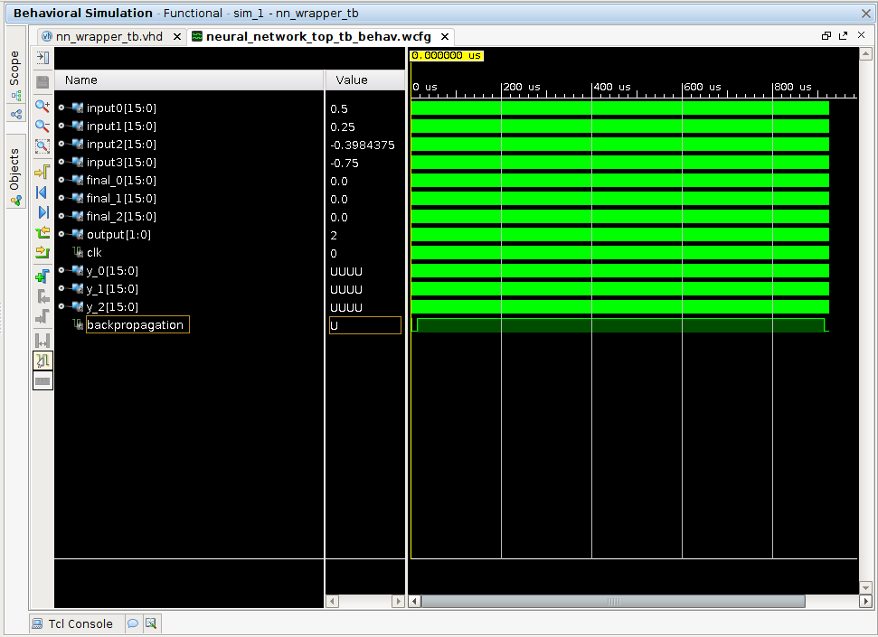

Slide 24
Example Data Samples (from IRIS Data Set)
Stem Length = 4.8
Stem Width = 3.4
Petal Length = 1.9
Petal Width = 0.2
Flower Type = 0
Stem Length = 6.1
Stem Width = 2.8
Petal Length = 4.7
Petal Width = 1.2
Flower Type = 1
Stem Length = 6.5
Stem Width = 3.0
Petal Length = 5.8
Petal Width = 2.2
Flower Type = 2

Slide 25
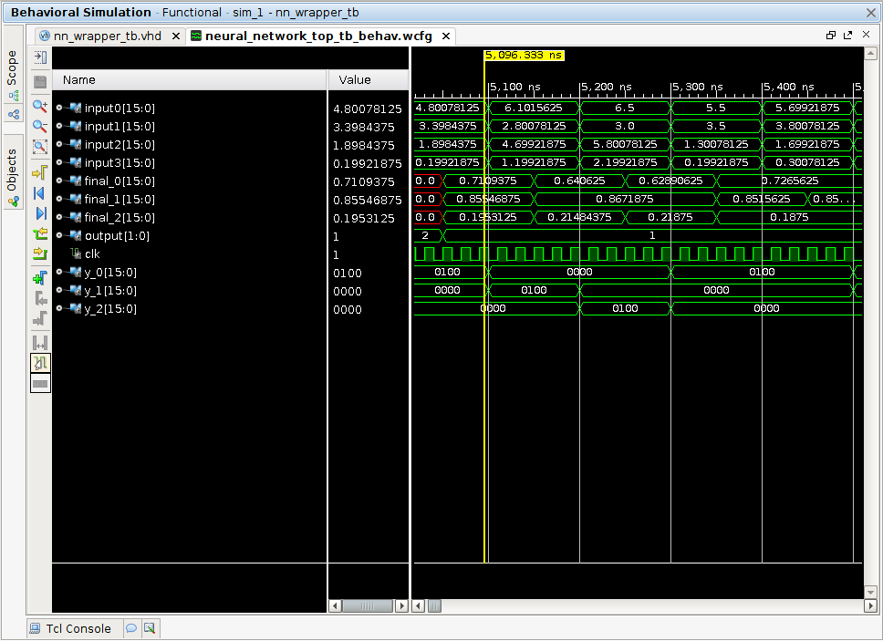

Slide 26
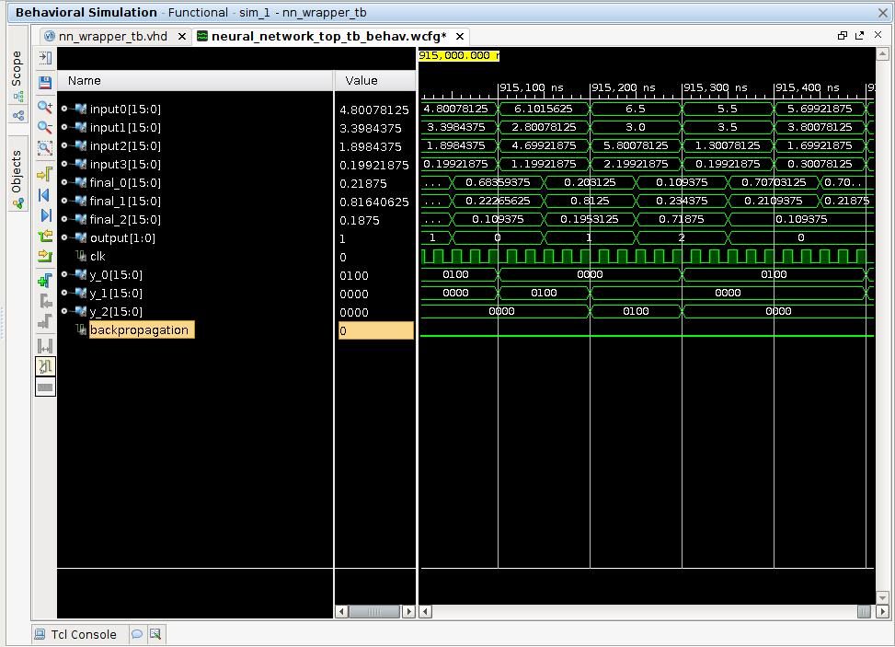

Slide 27
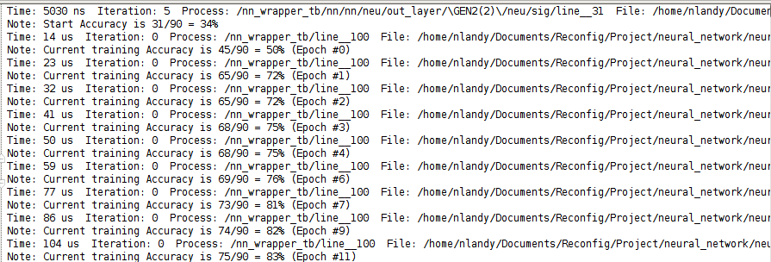

Slide 28
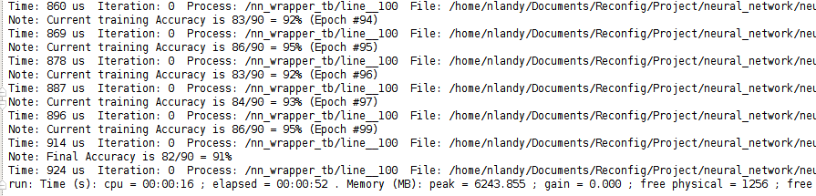

Slide 29
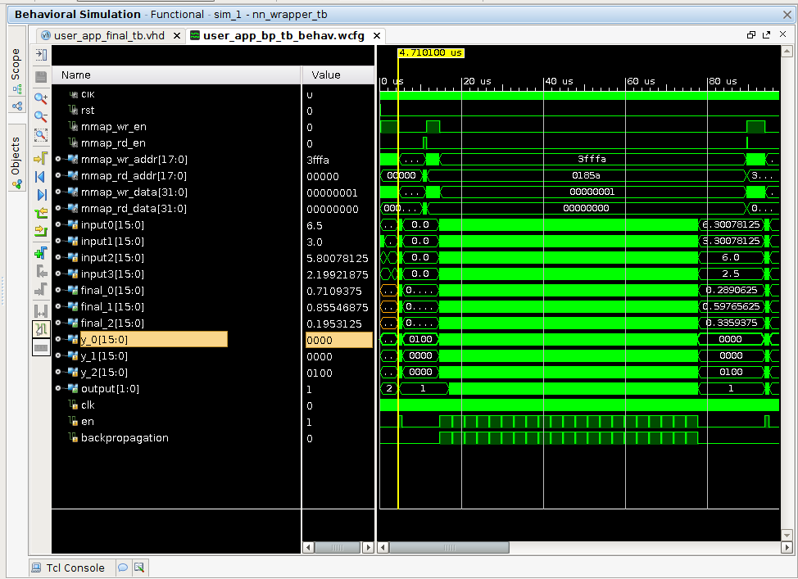

Slide 30
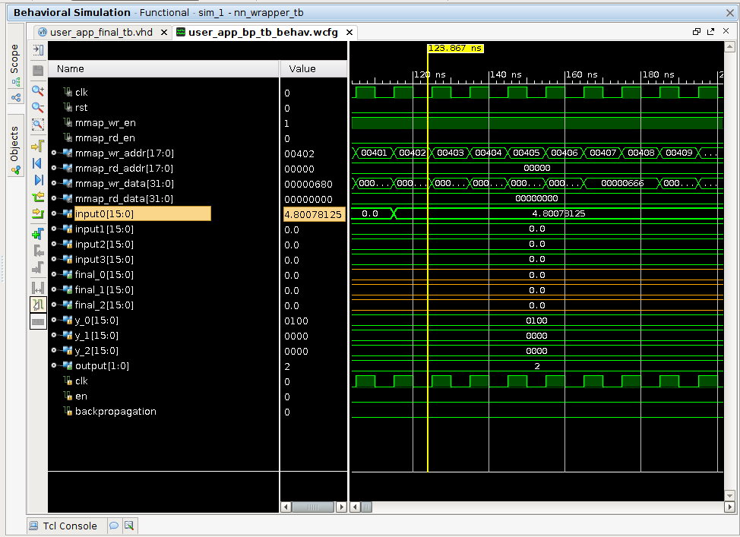

Slide 31
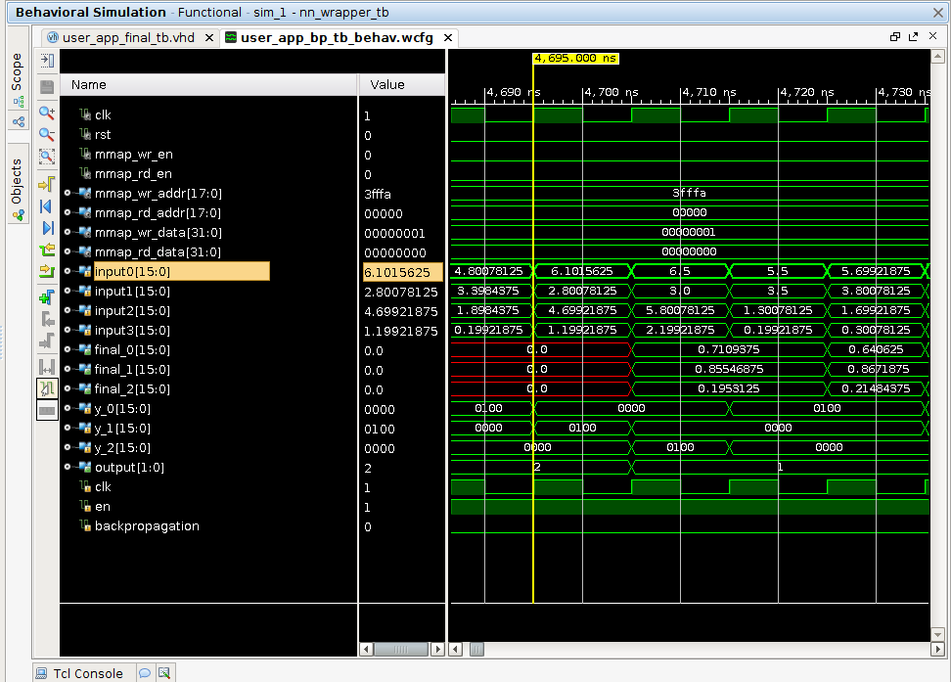

Slide 32
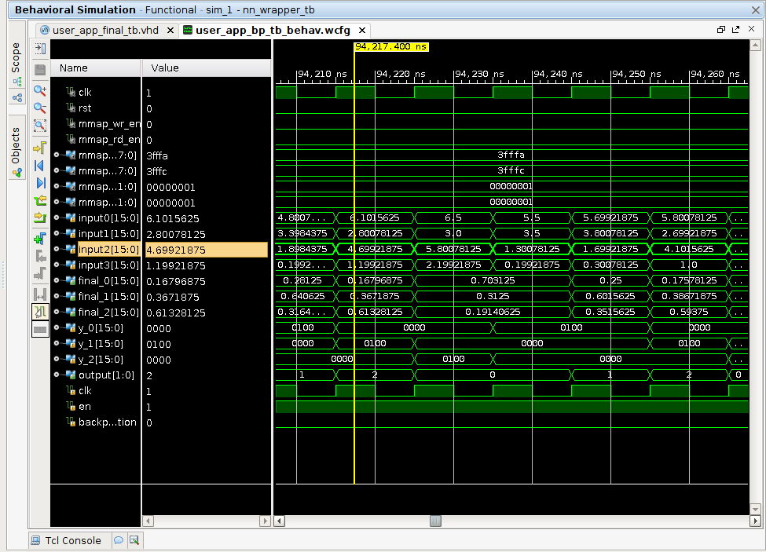

Slide 33
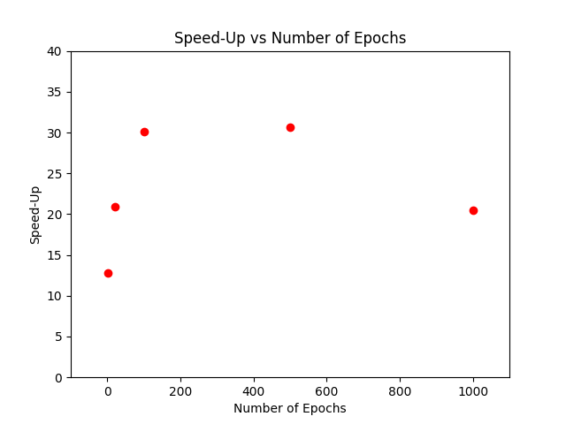
Performance

Slide 34
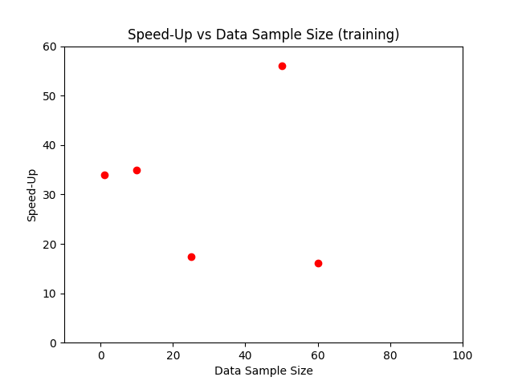
Performance

Slide 35
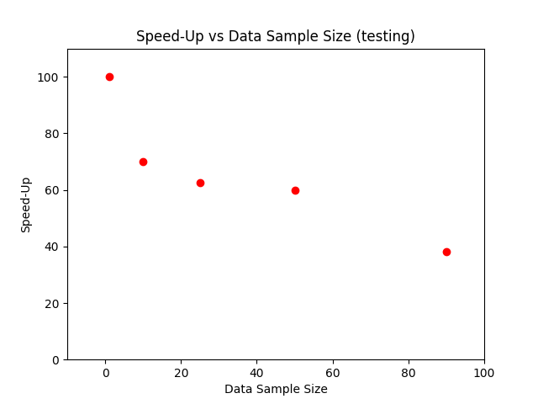
Performance

Slide 36
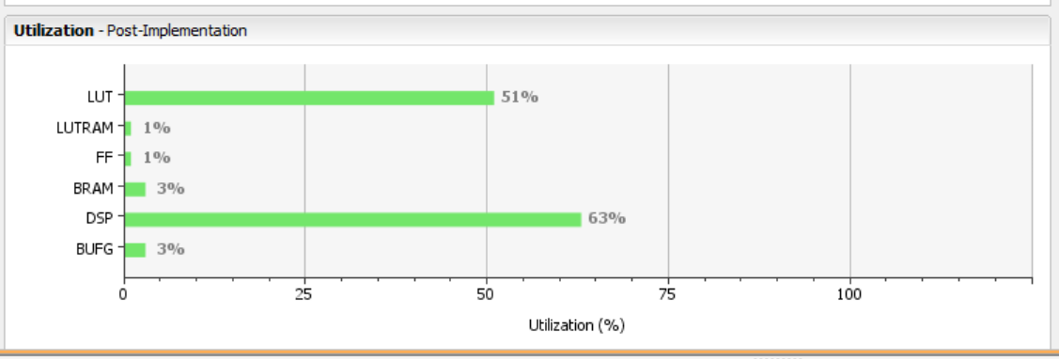
Utilization

Slide 37
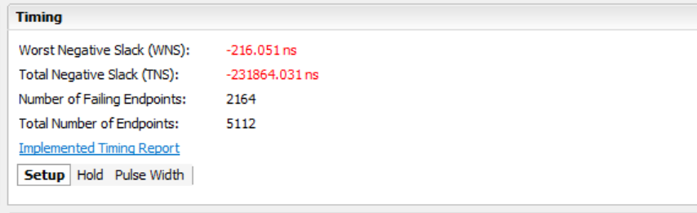
Timing

Slide 38
Other Notes
Utilized (8.8) signed fixed point library to limit resource usage
Used array data types to help organize large matrix and vector operations
Hierarchical Design (23 design files in total)
Large amount of parameterization (learning rate, epoch size, number of epochs, layer sizes, data widths for signed fixed point data, pipelining/non-pipelining)
Exhibits good speedup for resource intensive operations (especially for forward pass where we use pipelining)

